Slide 1
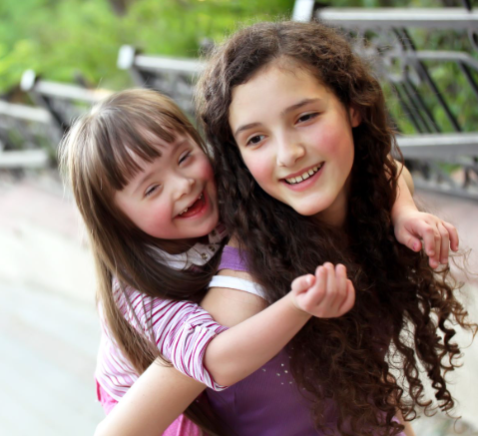

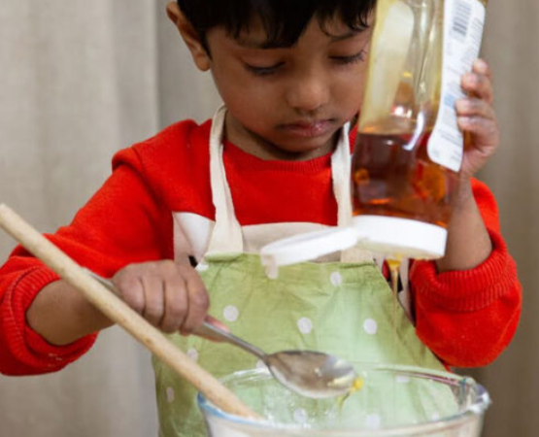
Who are Young Carers?

Slide 2

What is a Young Carer?
A Young Carer is someone who is under the age of 18 and they help to look after someone in their home.
This could be a parent, a brother, a sister or a grandparent.
They might help because the person is unwell, disabled, or they may struggle with their feelings or behaviour.

Slide 3
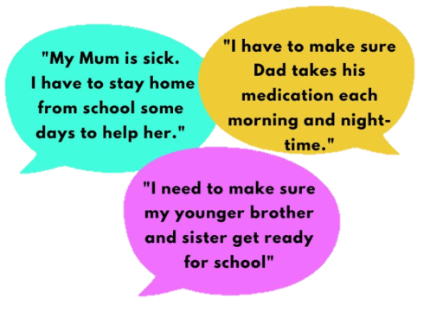
What do Young Carers do?
A lot of Young Carers help out with the jobs around the house, such as:
Cooking
Cleaning
Doing the food shopping
Young Carers may also take on other responsibilities like helping their younger siblings get dressed or have a bath. They may need to remind their family member to take their medicine.

Slide 4
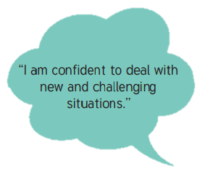
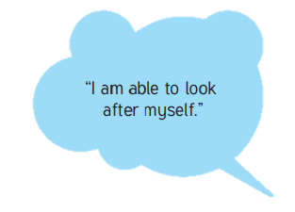
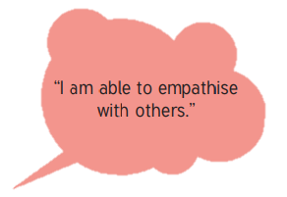
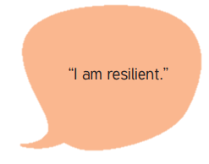
How does it feel to be a Young Carer?
It can be quite tough to be a Young Carer. You may feel like lots of people rely on you and you may worry about getting all of your jobs done. With all the hard work you do to support the people you love, you may feel tired, stressed and maybe a bit lonely.
It can be difficult sometimes, but there are positives too, you should be proud of what you can achieve.

Slide 5

We are here to help.
If you think you are a Young Carer, you are not alone!
There is support here at St Katherine’s:
Miss Croucher’s office (The Garden Room) has a Young Carer’s Voice box – in here you can write down any feeling you may have, positive or negative, and pop it in the box.
We have a Young Carers club. Here you will be able to join in with some fun activities with other Young Carers. It’s a great place to find support.
I love my family and friends.
I feel supported.
I enjoy being at school with my friends and teachers.
I am proud of myself.
Things Young Carers have said at our group.

Slide 6


Young Carers Champions!
There are two Young Carers champions at St Katherine’s
Miss Aikenhead Miss Croucher
Miss Aikenhead and Miss Croucher are the Young Carers Champions. This means that they are there if you need a chat and or a quiet place.
Come and find us if you would like to speak about anything mentioned today.

Slide 7
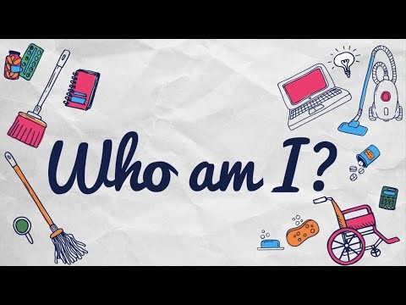
Have a listen to this poem written by young carers.
If you find anything upsetting, please speak to a trusted adult.

