Slide 1







World Mental Health Day
Wellbeing Warriors
Be the reason
someone
smiles today.
Who I am is more than enough!

Slide 2

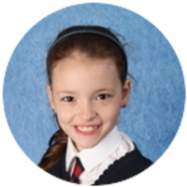
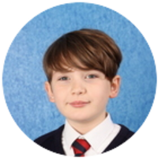
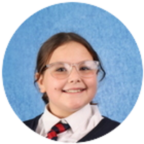
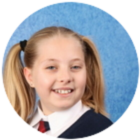
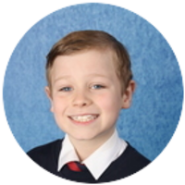
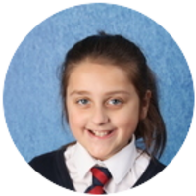
Who are the
Wellbeing Warriors?
Neve
Harry
Ella
Belle
Charlie
Joleigh

Slide 3


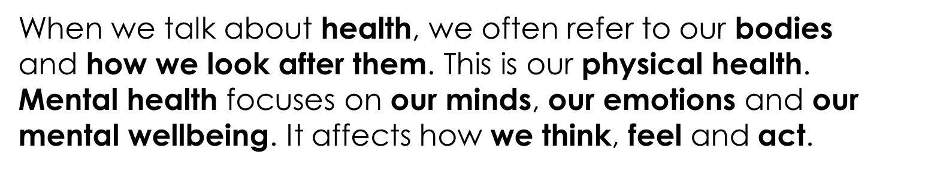
What is Mental Health and Wellbeing?
Mental health affects how we handle things in our daily lives such as the choices we make, how we treat others, how we behave and how we deal with different situations.

Slide 4

What is World
Mental Health Day?
World Mental Health Day is celebrated today
Thursday 10th October.
Word Mental Health Day aims to raise awareness of mental health issues around the world, promote discussion about feelings and emotions and encourage us to think about how we can support our own and others’ mental health.
World Mental Health Day encourages everyone to talk
about their feelings.

Slide 5

Emotions
How do you sometimes feel?
Some emotions can make us feel good and some can make us feel uncomfortable.
It is OK to feel different emotions.
What different emotions can you see?

Slide 6

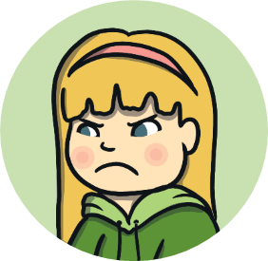
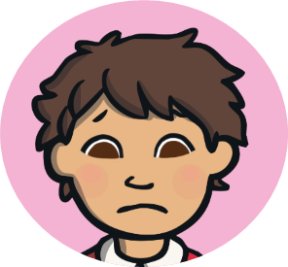

Emotions
Throughout the day, we can experience a range of different emotions. Some of these emotions can make us feel good and some of them can make us feel uncomfortable. It is OK to feel different emotions.
There are things that people can do in their daily lives to feel good on the inside and look after their mental health.

Slide 7
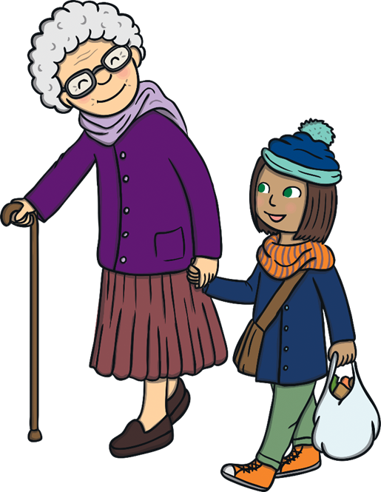

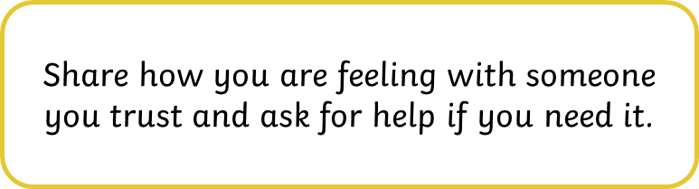
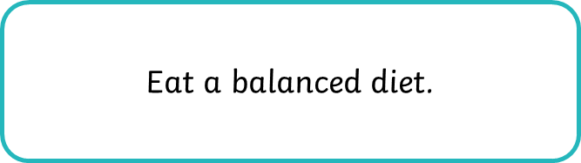



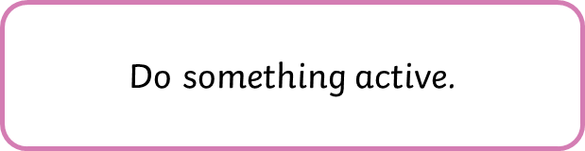
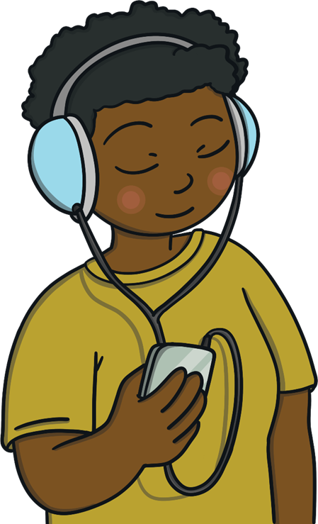

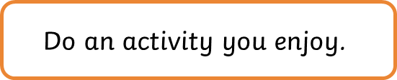
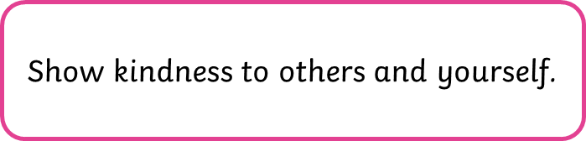
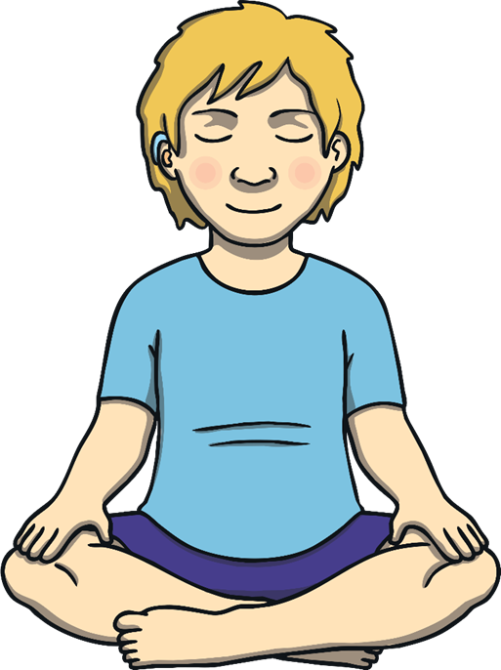

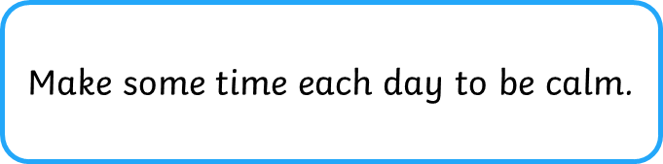
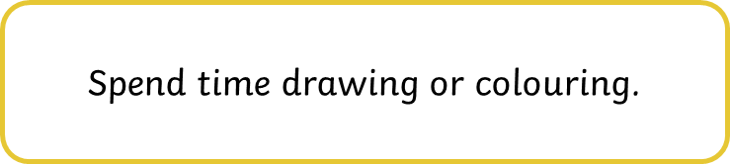
Supporting Our Mental Health
Just like with our body, it is important that we do things to help our minds to be healthy, be in good condition and feel well. There are things we can do to look after our mental health and wellbeing.

Slide 8


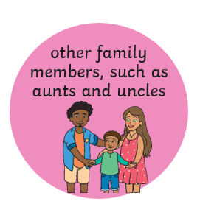




Who Can Help?
It is important to talk to an adult about
your emotions and how you feel.
An adult you can trust is someone you feel safe with, who makes you feel comfortable and who you can ask for help when you need it.
Who could your trusted adult be?

Slide 9
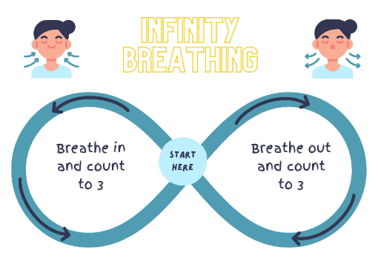
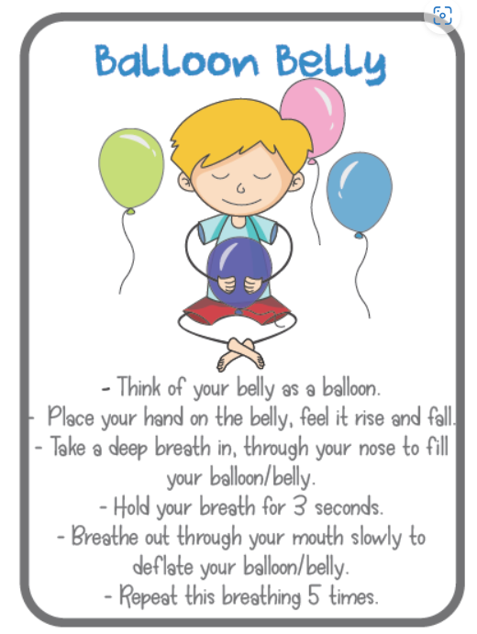
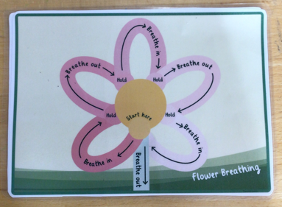
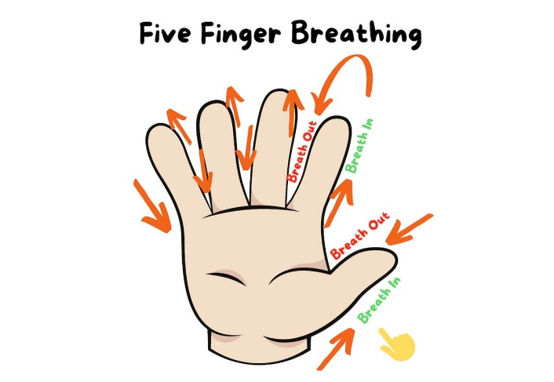
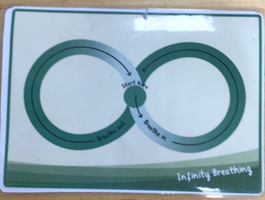
Supporting Our Own Mental Health
How you can
help your self?

Slide 10
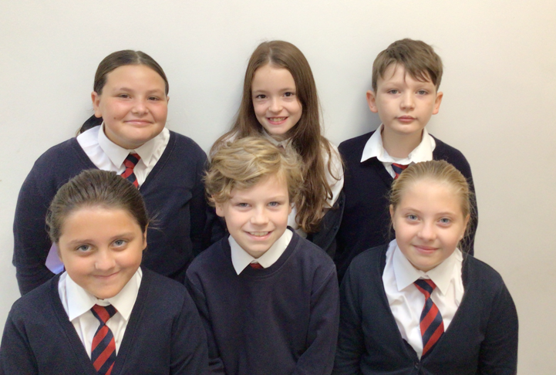



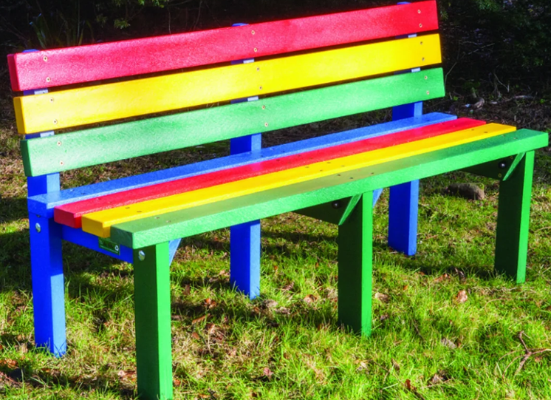
Wellbeing Wednesday
Every Wednesday we will be having ‘Wellbeing Wednesday’ where we will be by the coloured bench on the lower and upper playground to support your wellbeing.
Come and have a chat with us if you want to
and even do some mindfulness!

Slide 11
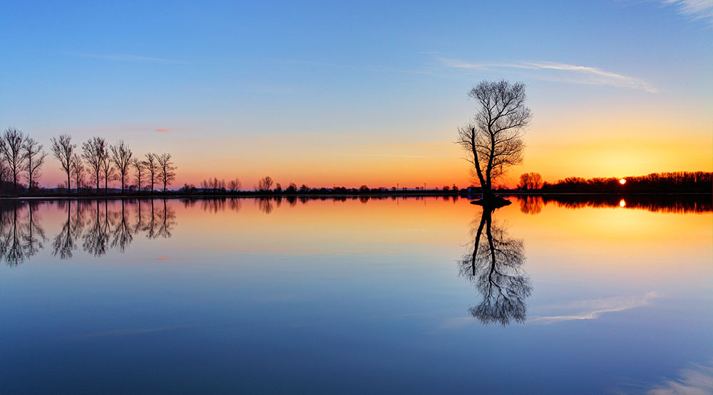



Reflection Time
All people have the right to have help in looking after their mental health and wellbeing.

